Slide 1

De-stressing
Family Life
Michelle Cassidy
April, 2015

Slide 2
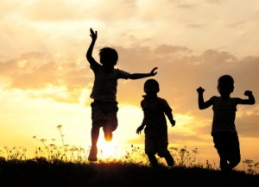
Notes:
Just a typical day after school………..NOT QUITE!

Slide 3
Who we are and how we engage in the world are much stronger predictors of how our children will do than what we know about parenting. The question isn’t are you parenting in the right way? It is Are you the adult you want your child to grow up to be?
Brene Brown

Slide 4
A case of the….
Ya buts………..

Slide 5
The Relationship to Mental Health
Wellbeing is not about absence of illness but about health and resiliency:
Self regulation
Self concept
Self acceptance
Connectedness/Belonging

Slide 6
If the day ever came when we were able to accept ourselves and our children exactly as we are and they are, then, I believe we would have come to an understanding of what "good parenting" means.
Fred Rogers

Slide 7
Why is this important?
Long term impacts of chronic stress
Brain adapts to protect itself
We can model coping strategies and stress reduction for our kids
Reduced parental stress= Reduced child stress

Slide 8
A bit about the brain
Designed to keep our body in balance
Our body craves homeostasis
The brain supports adaptive functioning
It is hardwired to protect us

Slide 9
Why is this important?
Flight,
Fight,
or
Freeze

Slide 10
A Helpful Brain Model for Families
http://www.youtube.com/watch?v=DD-lfP1FBFk

Slide 11
Self Regulation: Putting on the Brakes
We need our brain to have the alarm system, we wouldn’t want to turn if off BUT higher level cortical functions help us moderate it
Plasticity allows us to strengthen how the brain regulates
Notes:
CASSIDY

Slide 12
Changing Our Response

Slide 13
Responses to Stress:
Mind-Body-Behaviour Relationship
Mind (cognitive response):
negative thoughts, attitudes and feelings
Body (physiological response):
physical symptoms and bodily reactions
Behaviour (behavioural response):
things you do to cope

Slide 14
Understanding the Triad
MIND
Thoughts/Feelings
Behaviors
BRAIN/BODY
Physiology

Slide 15
Exercise
You are sitting in your room at night reading. You hear a noise/knocking at the window…..
Your first thought is…..

Slide 16
Exercise
What was your thought?
i.e. animal, branch, person/burglar
What did you say to yourself?
i.e. “ no big deal” (branch)
“oh no, I’ve got to get out of here” (burglar)
What feeling did your thoughts lead you to have?
i.e. fear/dread (burglar)
How would that feeling influence your behavior?
i.e. run/hide/shake/tremble

Slide 17
Understanding Our Needs
The foundation for finding the calm in the chaos

Slide 18
Connectedness and Belonging
The energy that exists between people when they feel seen, heard, and valued;
when they can give and receive without judgement; and when they derive sustenance and strength from the relationship.
Brene Brown

Slide 19
Caring Relationships and
Belonging
Brain is hardwired for belonging and connection
Survival instinct
This is a pivotal mediator in identity development

Slide 20
Connectedness and Attachment
Dr. Gordon Neufeld
Hold on to Your Kids
Why kids need us more than their peers.
Competing attachment
What is happening?
http://www.youtube.com/watch?v=UlMkWJY5T_w

Slide 21
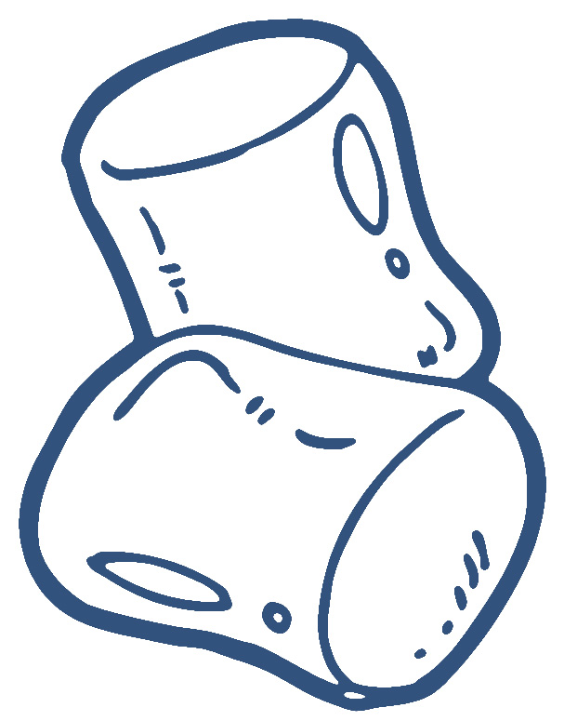
The Marshmallow Test
Revisited

Slide 22
Increasing Connectedness
One on One time (pick from the jar)
Create structure, set your family up for success
Tech Free Time
Talk over problems in a relaxed way, not when your primal brain is driving the process
Use scaling questions as a way to restore the calm

Slide 23
Family Mealtimes
Schedule them if you have to
No technology, including answering the phone
Structure the conversation, must be positive
Play soothing dinner music, have each family member create a playlist and rotate them
Devote one meal month to each family member (choice of meal, pick the positive conversation starter, and 1 affirmation)**identity development

Slide 24
What we are teaches the child more than what we say, so we must be what we want our children to become.
Joseph Chilton Pearce

Slide 25

Taking Care of You
How to integrate self care

Slide 26
Managing your Own Response
Your own brain’s response
What attributions are you making?
What reactions are you having when you feel powerless?
How do you continue to convey acceptance for them when you are frustrated?

Slide 27
It starts with YOU
Imagine a “you first” day…..
What would it look like?
What would you be doing?
Who would be with you?
Is there any part of that day you can bring in to your life intentionally, even if it is just one hour per week….

Slide 28
BEHAVIOR
Keeping our social connections
Not isolating ourselves when the going gets tough
Allowing ourselves to be vulnerable and seek support
Integrating more joy giving activities into our lives

Slide 29
Take Care of You and You will take care of your family
Make time for yourself
Build a support network
Practice stress reduction
Get help if you feel your stress level is impacting you in ways you cannot manage
Notes:
Stress becomes a problem when you feel overwhelmed by the things that happen to you. You may feel “stressed out” when it seems there is too much to deal with all at once, and you are not sure how to handle it all.
When you feel stressed, you usually have some physical symptoms. You can feel tired, get headaches, stomach upsets or backaches, clench your jaw or grind your teeth, develop skin rashes, have recurring colds or flu, have muscle spasms or nervous twitches, or have problems sleeping.
Mental signs of stress include feeling pressured, having difficulty concentrating, being forgetful and having trouble making decisions.
Emotional signs include feeling angry, frustrated, tense, anxious, or more aggressive than usual.

Slide 30
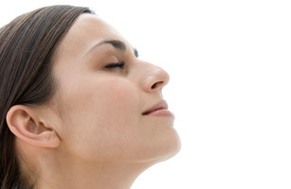
Strategies: Take up Smoking
Just kidding!
Why this works:
Taking a break physically from place/environment which generates stress
Deep breathing
3 breath hug
Let’s practice…

Slide 31
Man can alter his life by altering his thoughts.
William James
Notes:
Shilagh

Slide 32
Neurons that fire together…
Wire together
Where you focus attention stimulates certain parts of the brain
We are wiring our pathways
Let’s learn how to control it
CHOOSE to focus on the positive

Slide 33
Practice Letting Go
http://www.youtube.com/watch?v=rSrSemQUeSI

Slide 34
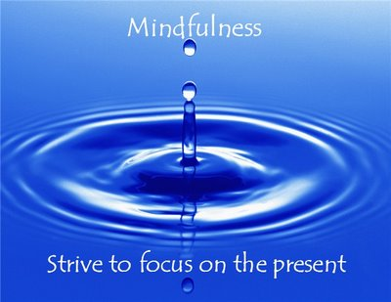

Slide 35
Mind, Body, and Behavior
Mindfulness
Paying attention to the present…
Without judgement
Without expectations
Without fear
Just accept it as it is….
Let’s practice

Slide 36
Mindfulness
A seated meditation may be easiest OR a body scan
MARC.ucla (Mindfulness Awareness Resource Centre) meditation recordings iTunes U
Guided Mindfulness
(free audio guided meditations)

Slide 37
Self Compassion
Not about judging ourselves positively, but a way of relating to ourselves kindly, embracing ourselves lovingly flaws and all

Slide 38
Self Compassion
The thing that is really hard, ,and really amazing, is giving up on being perfect and beginning the work of becoming yourself.
Anna Quidlen
http://www.self-compassion.org/
Treating yourself as you would a good friend

Slide 39
Are you ready to change the lens?
http://www.ted.com/talks/shawn_achor_the_happy_secret_to_better_work?language=en

Slide 40
The 21 day Challenge
Daily:
Write down 3 new things you were grateful for that day
Journal one positive experience
Exercise
Meditation
One random act of kindness

Slide 41
Applaud yourself
Your job is HARD
All parents are doing the best job they can with the skills they have
Celebrate yourself

